Slide 1
Analysis of Cosmetic Online Business Payment Data (2020-2023)
HANEESHA THASNI N

Slide 2
Introduction
The online cosmetic market has grown quickly, particularly during the pandemic.
This project analyzes payment transaction data from a cosmetic e-commerce platform.
The data includes trends in payments, shipping, and order quantities.
It examines the move from offline to online payment methods.
The analysis provides recommendations to enhance business strategies and understand customer behavior better.

Slide 3
Data Overview
Dataset: Contains payment transaction details, such as amounts, payment types, providers, and locations.
Years Analyzed: 2020 to 2023.
Cities Covered: 261 cities across India.
Total Records: 13 columns x 1127 rows
Key Features: Date, City, Payment Amount, Payment Provider, Order Quantity, Shipping Cost, Discounts, and Status.
Data Source: Kaggle

Slide 4
Analysis
Payment trends over months and years.
Comparison of payment methods (Razor pay vs. offline).
Geographic analysis of payment distribution.
Order quantity trends across cities.
Correlation between shipping cost, order quantity, and discount.

Slide 5
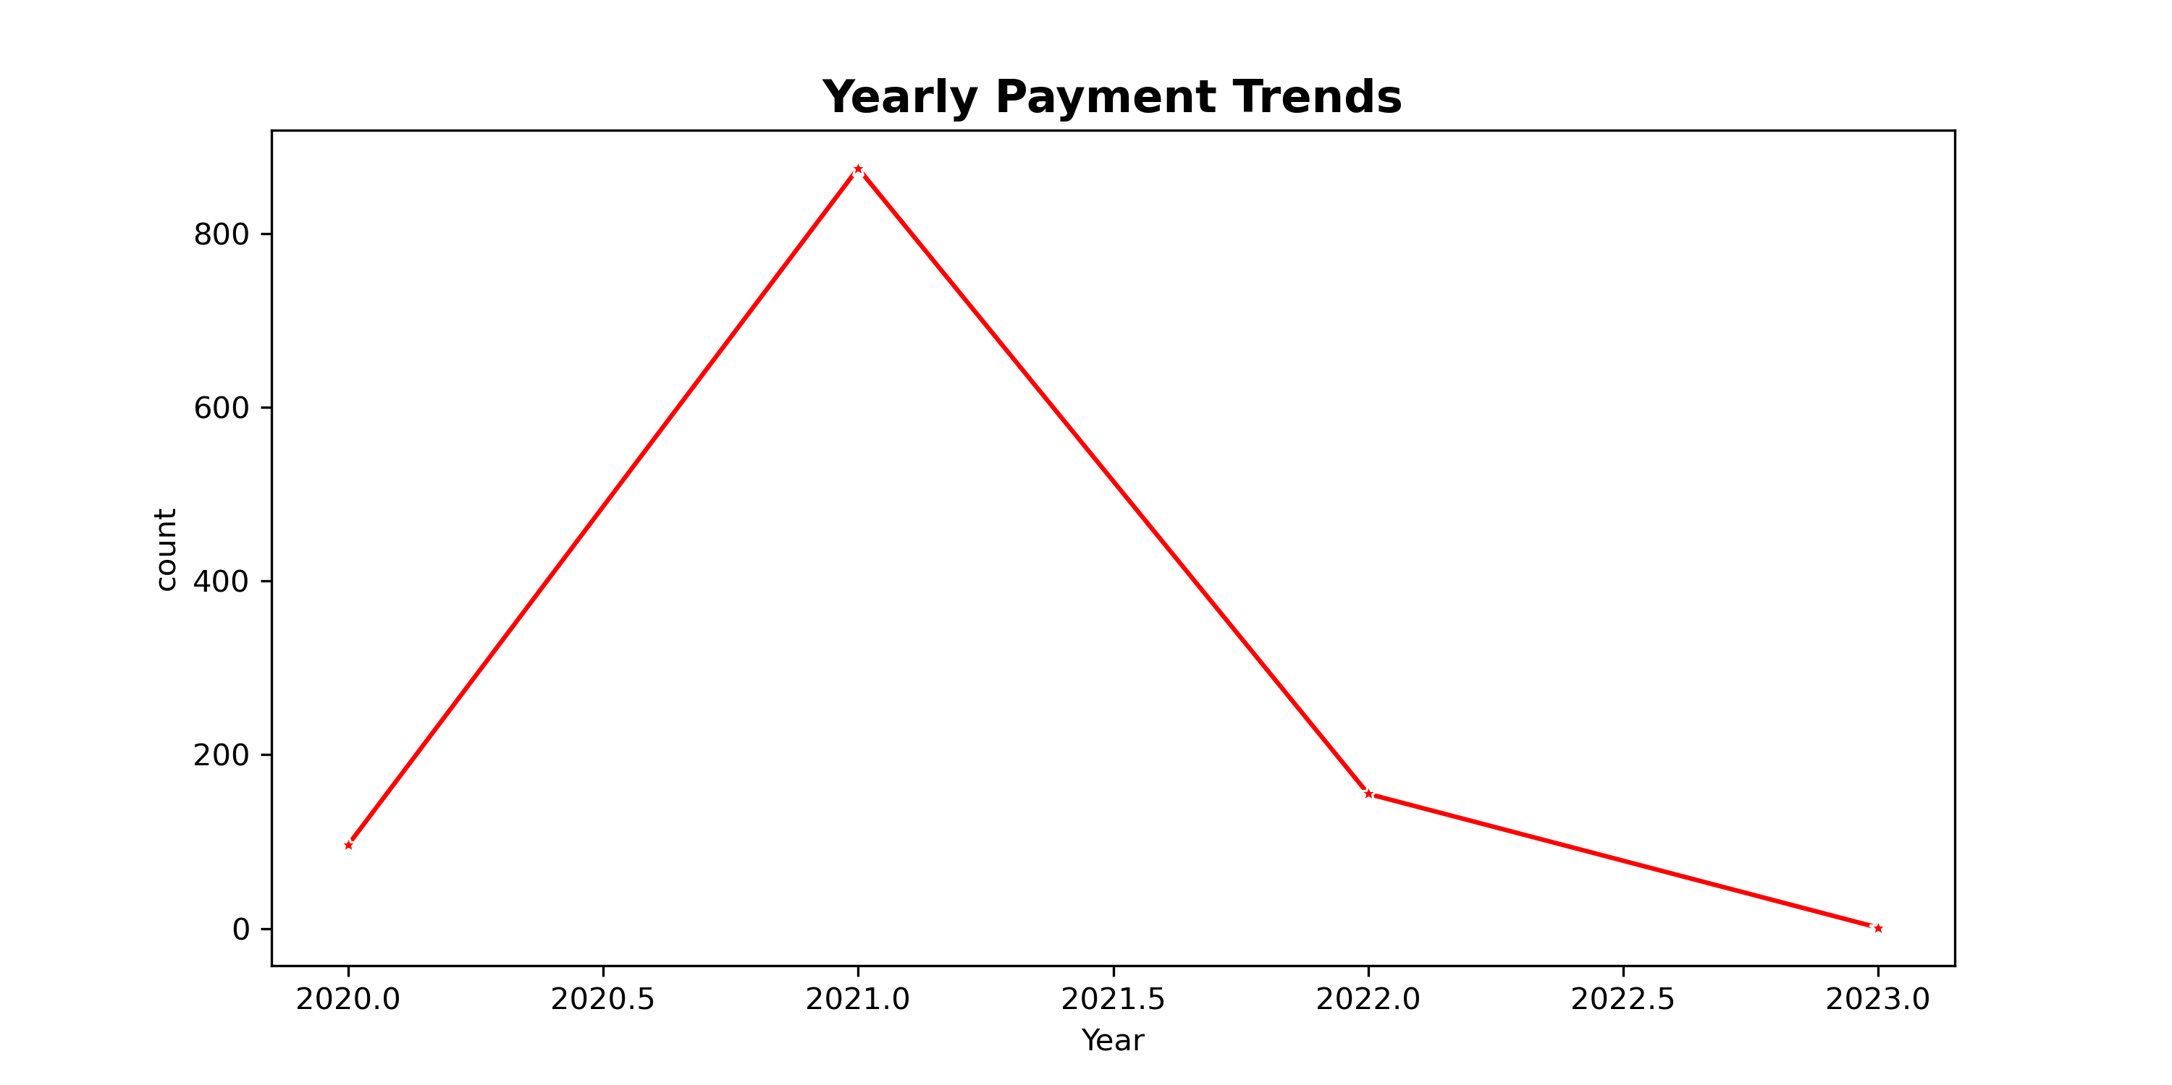
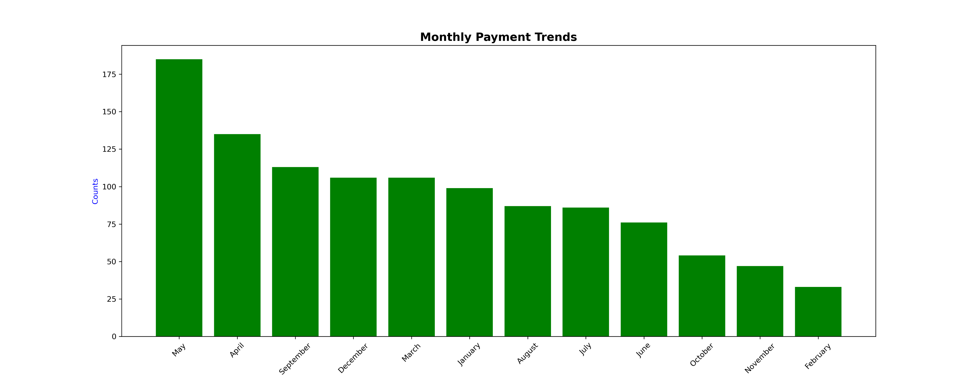
Payment Trends over Years and Months
In 2021, cosmetic online payments saw a sharp increase. However, starting in 2022, there has been a notable decline.
Payments for cosmetics are highest in May and April.

Slide 6
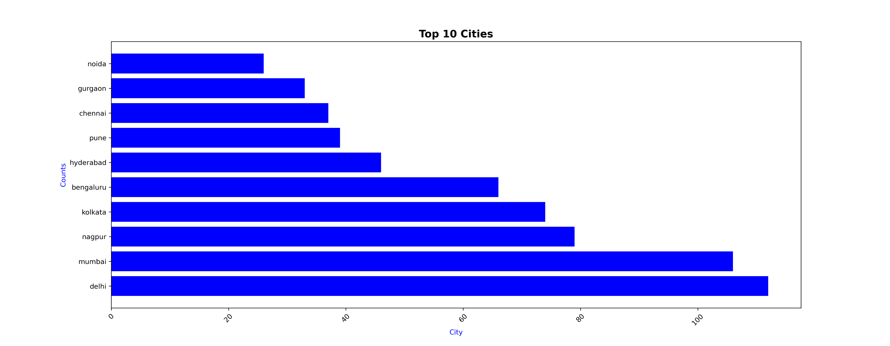
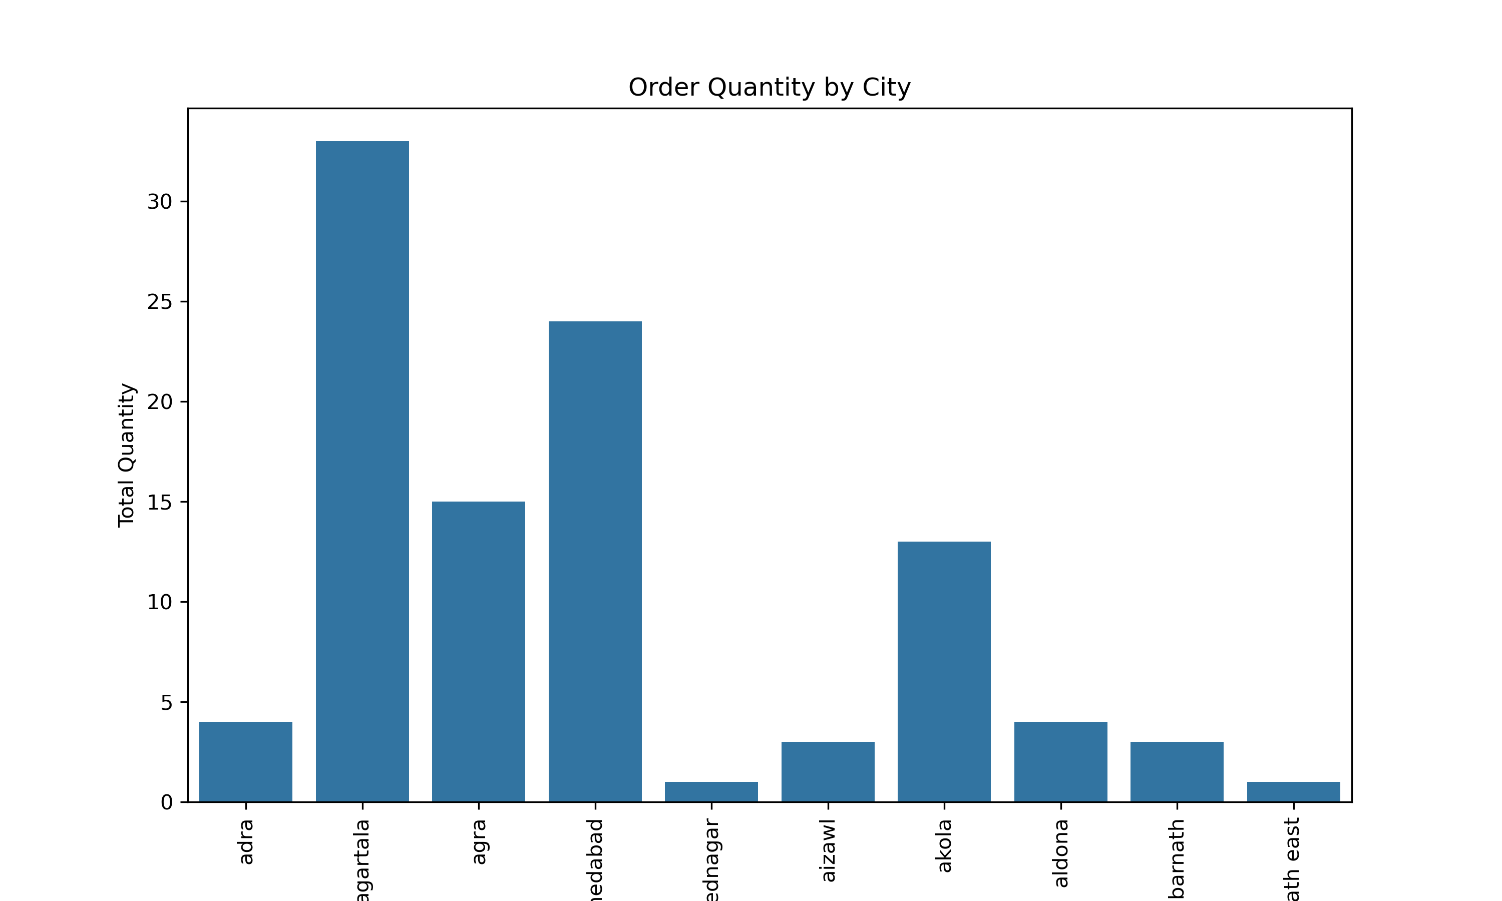
Order Quantity Trends across Cities
Orders by city
Order Quantity by City
Delhi leads cosmetic online payments in India with 112 transactions, followed by Mumbai with 106.
In terms of order quantity, Agartala ranks highest with 33 orders, followed by Ahmedabad with 24.

Slide 7
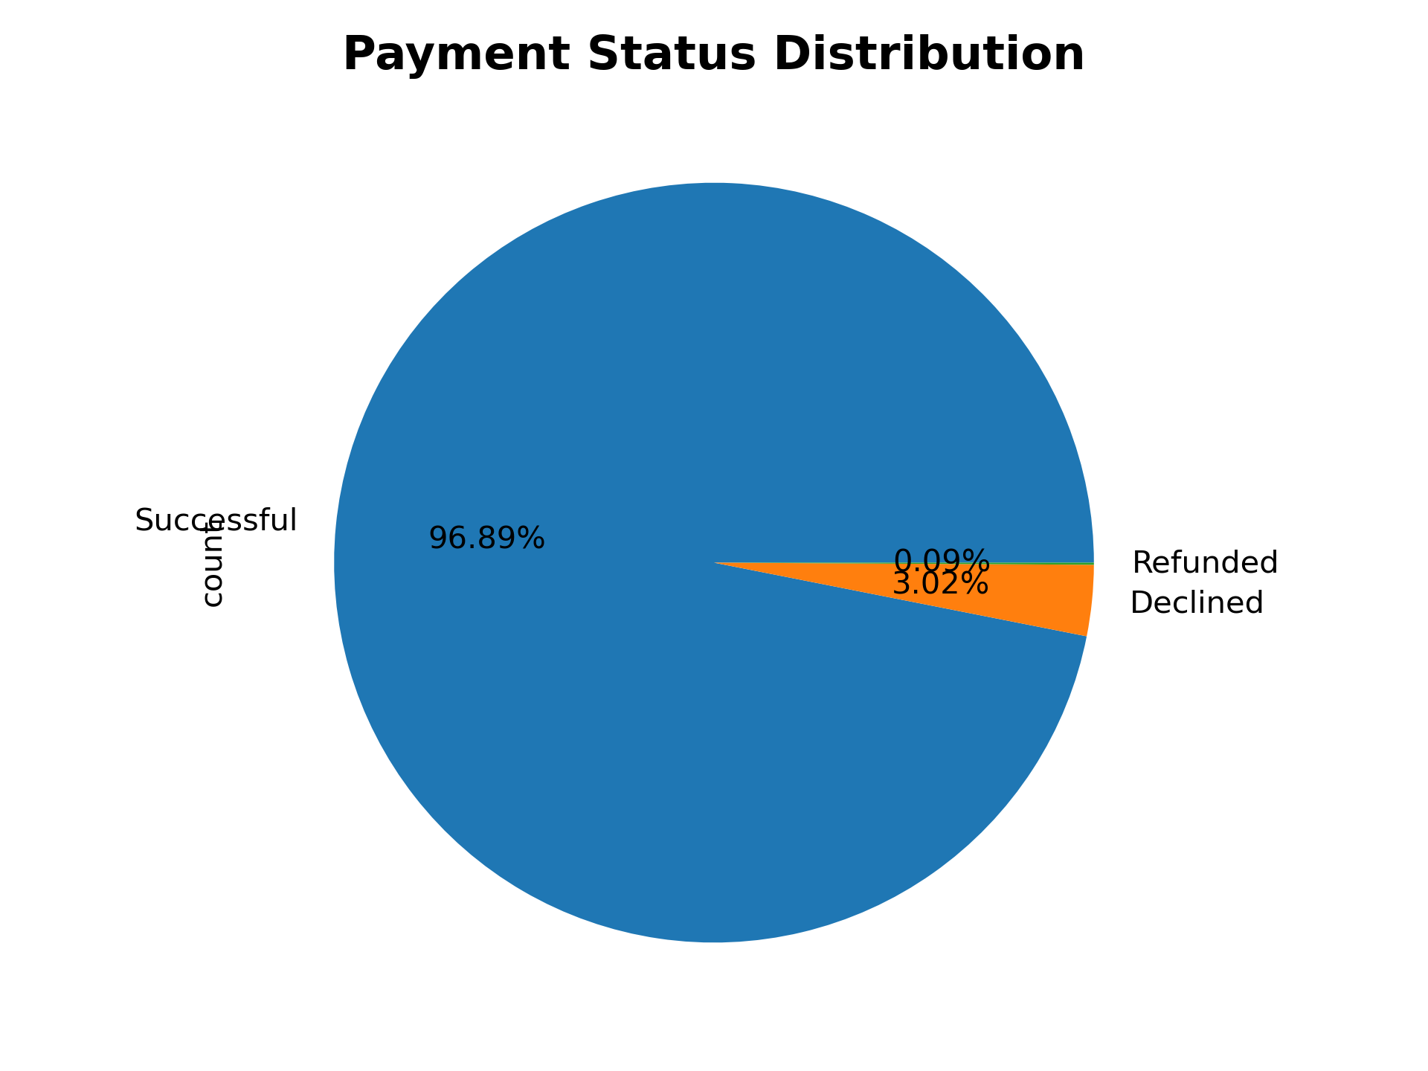
Geographic Analysis of Payment Distribution
These graph suggest that the online cosmetic business had a very efficient payment system with minimal issues.

Slide 8
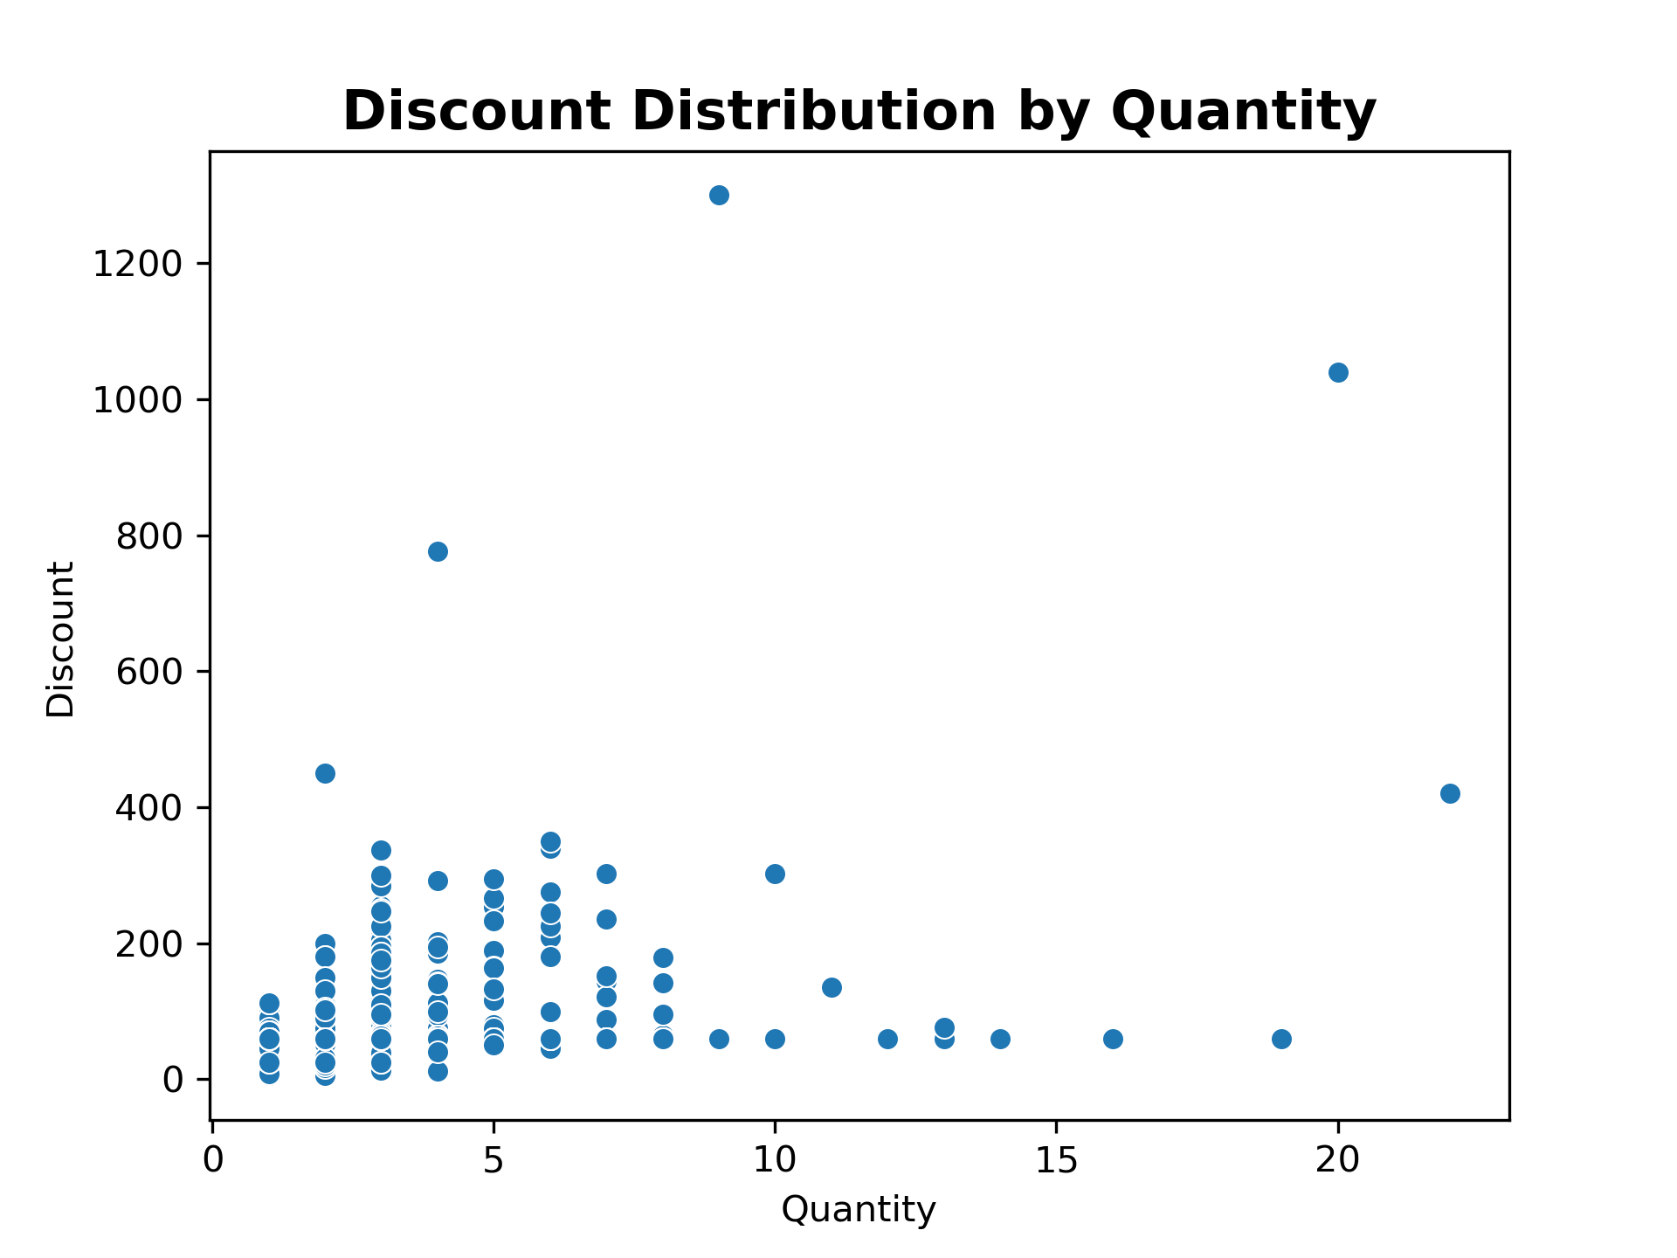
Analysis of Discount Distribution by Quantity
Higher quantities generally receive larger discounts, but the relationship is not consistent. There is significant variability in discounts for smaller quantities.

Slide 9
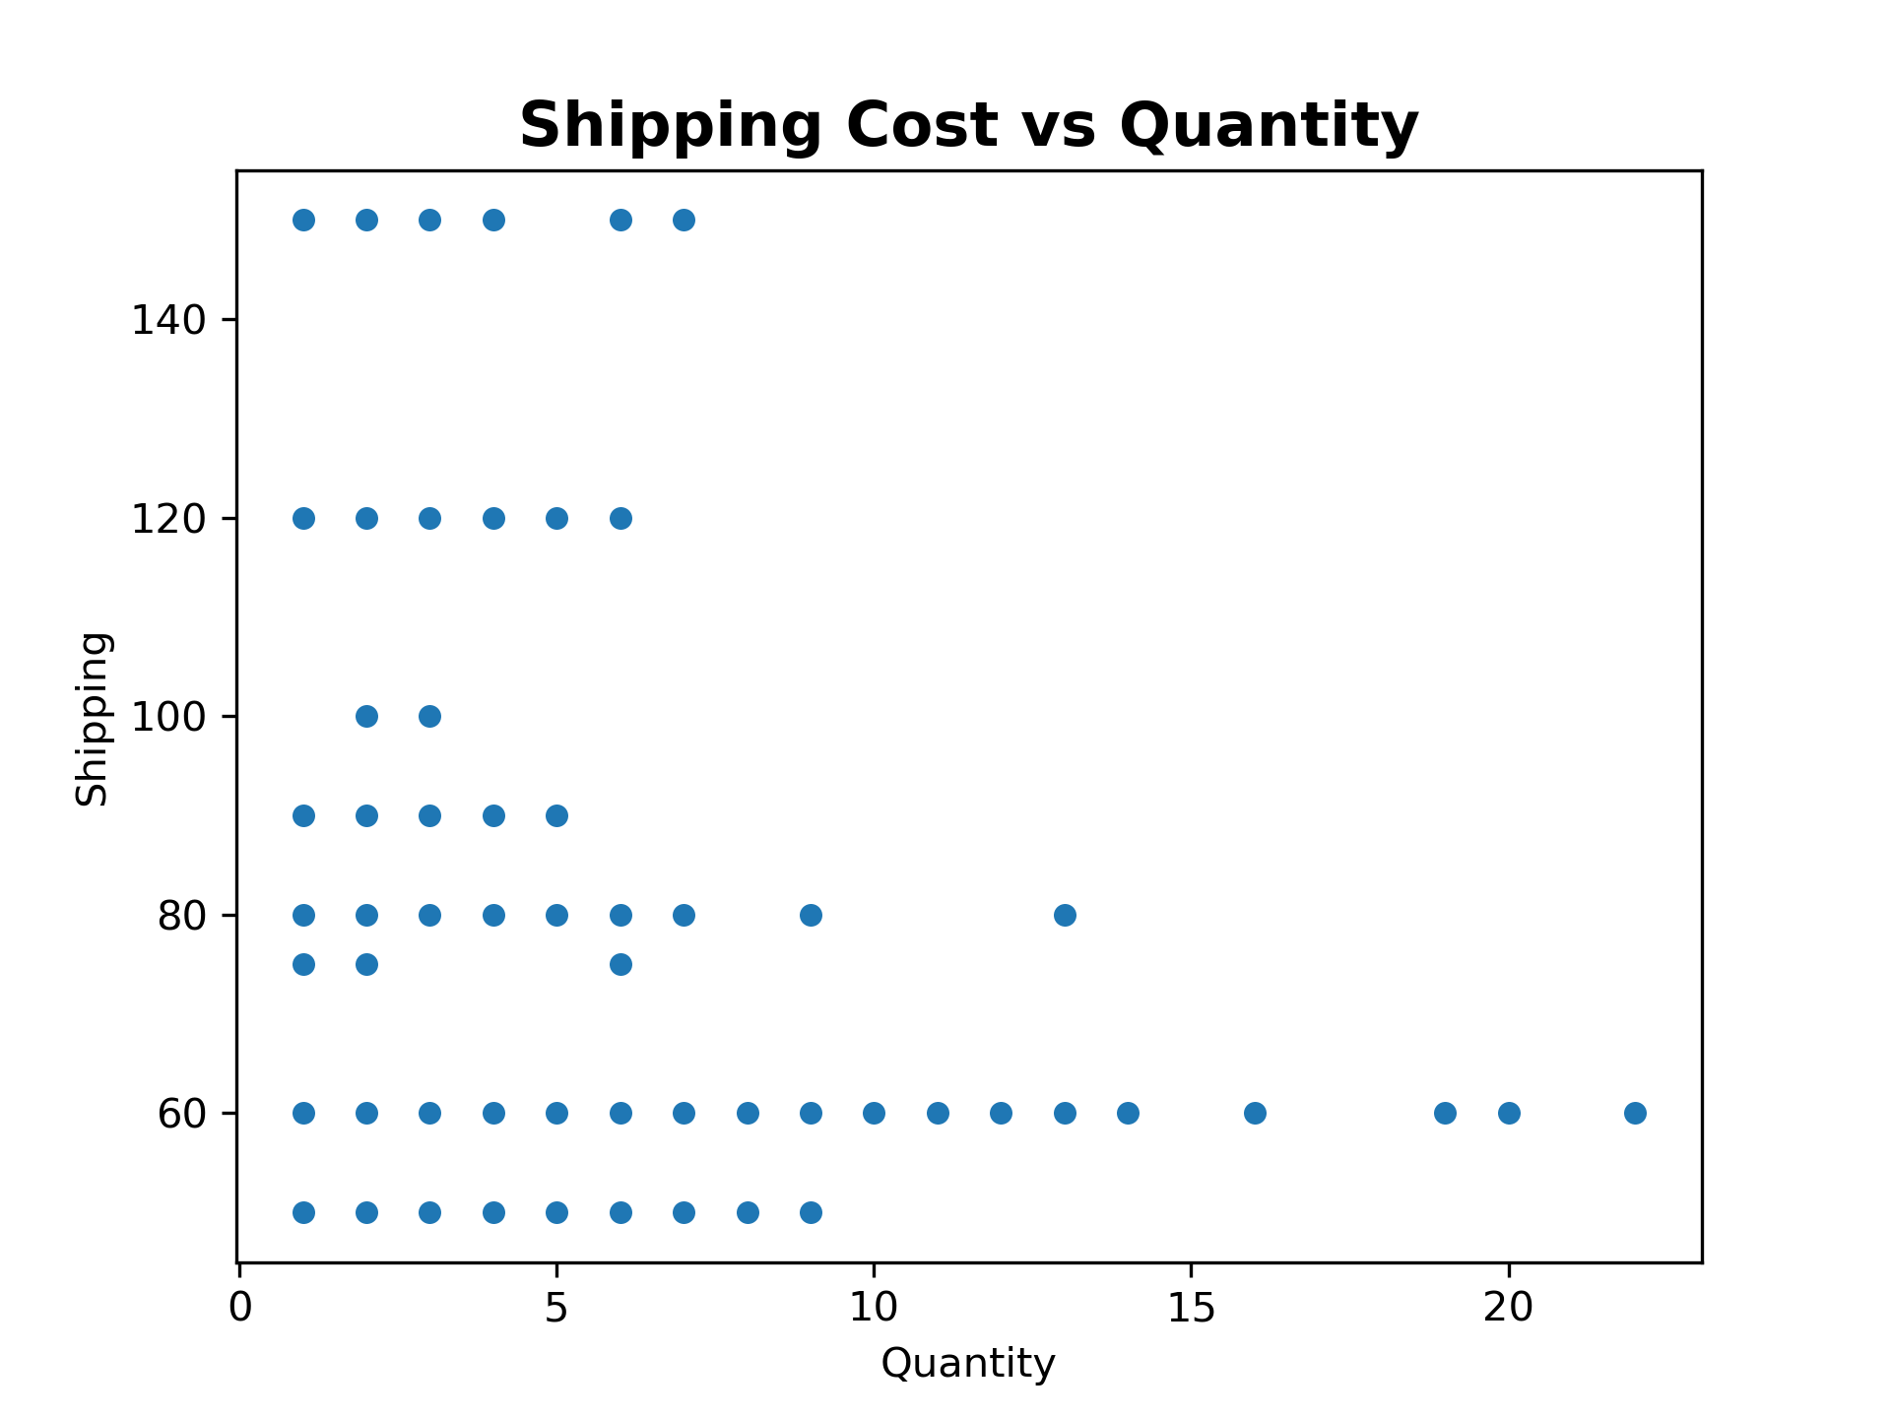
Relationship between Shipping cost vs. Quantity
This scatter plot suggests that there is no strong correlation between the quantity of items shipped and the shipping cost.

Slide 10
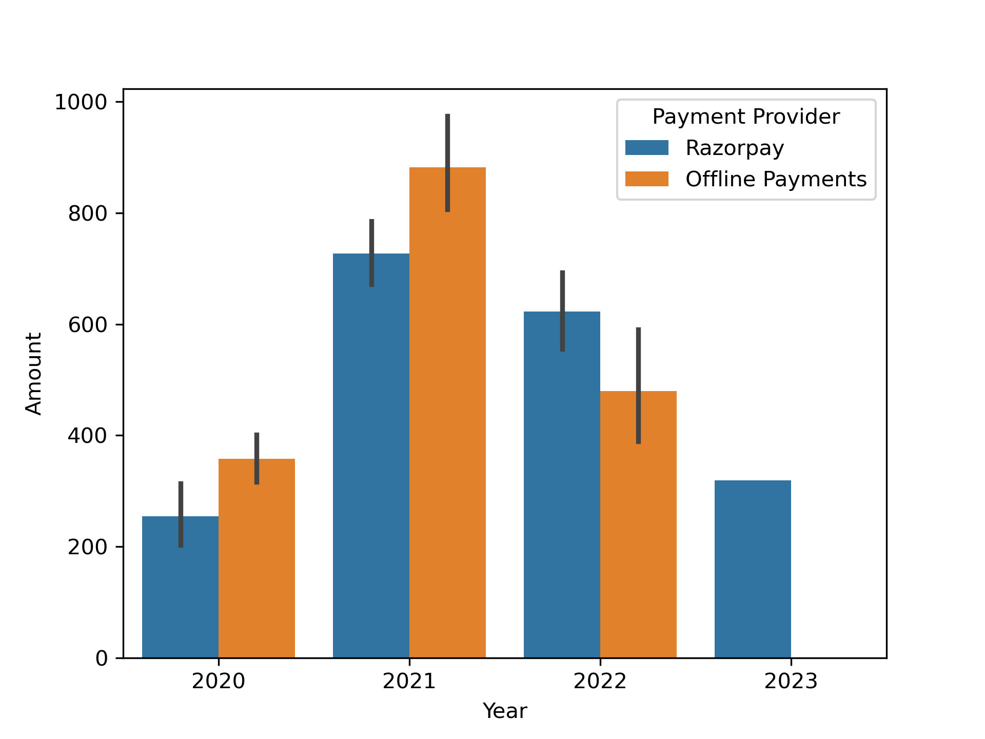
Annual Comparison of Payment Amounts Processed by Payment Provider
Before 2021, offline payments dominated, but by 2021-2022, Razor pay saw a significant rise. By 2023, it became the sole payment method.

Slide 11
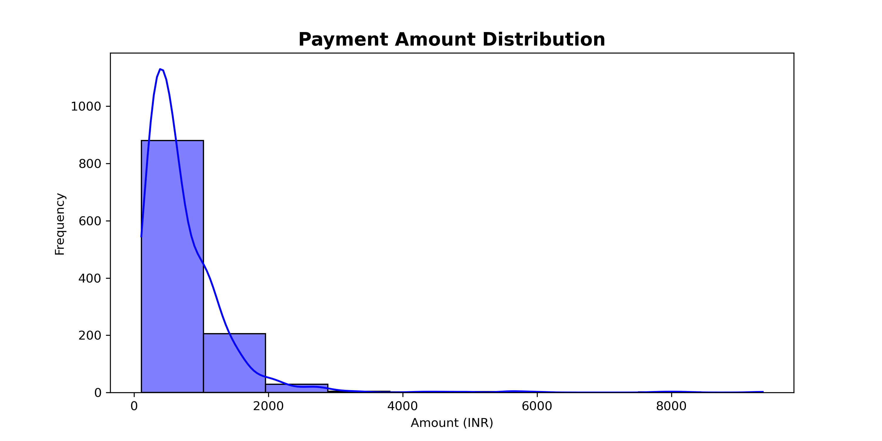
Payment Amount Distribution
Most payments are on the lower end, with fewer high-value payments. The distribution is right-skewed, indicating a higher frequency of smaller payment amounts.

Slide 12
Key Insights
Currency Usage: strictly localized operation
2021 Surge in Cosmetic Payments
2022 Decline in Payments
Monthly Payment Patterns: Highest in May and April, likely due to seasonal promotions and increased personal care.
Day-wise Payment Trends: Payments peaked on Wednesdays, possibly due to mid-week settlements.
City-wise Payment Insights: Delhi and Mumbai were the top cities for cosmetic online payments.
Order Quantity by City: Agartala led in order quantity, followed by Ahmedabad.
Shift from Offline to Razor pay

Slide 13
Recommendations
Expand in Key Markets
Tailored Discounts
Optimize Payment Processes
Monitor Market Trends
Shipping Efficiency

Slide 14
The analysis of payment transaction data from the online cosmetic business reveals significant growth, particularly during the pandemic. There has been a clear shift towards online payment methods, with major cities like Delhi and Mumbai leading in transactions. Understanding seasonal trends and customer preferences can help businesses enhance their strategies and engage more effectively with their audience.
Key Takeaways:
The online cosmetic market has expanded rapidly, especially during the pandemic.
There is a strong preference for online payments over traditional methods.
Targeted strategies based on city and seasonal trends can improve business performance.

Slide 15
Thank You

